Slide 1

Rationale
Introduction to Windows Store App Development Using HTML5 and JavaScript
Computer science is a field of study that deals with solving a variety of problems by using computers.
  To solve a given problem by using computers, you need to design an algorithm for it.
Multiple algorithms can be designed to solve a particular problem.
An algorithm that provides the maximum efficiency should be used for solving the problem.
  The efficiency of an algorithm can be improved by using an appropriate data structure.
Data structures help in creating programs that are simple, reusable, and easy to maintain.
This module will enable a learner to select and implement an appropriate data structure and algorithm to solve a given programming problem.

Slide 2
Objectives
  In this session, you will learn to:
  Apply styles to UI elements
Notes:
2

Slide 3
Applying Styles to UI Elements
  Every app needs to carry a look and feel that matches its requirement and suits its purpose.
  Example:
Adventure game app
Appealing, bright, and bold look
News app
Subtle look
Notes:
3

Slide 4
Applying Styles to UI Elements (Contd.)
  You can apply styles to UI elements of your app to create different types of looks.
  You can style your apps by using:
WinJS
style sheets
CSS
Notes:
4

Slide 5
Using WinJS Style Sheets
  WinJS provides two default style sheets that can give your app the Windows 8 look and feel.
ui-dark.css
ui-light.css
Defines a dark background and a light foreground.
Defines a light background and a dark foreground.
Notes:
5
The image is added in the images folder of the project.

Slide 6
Using WinJS Style Sheets
(Contd.)
  The ui-dark.css and ui-light.css files define various types of styles.
Base styles
Include styles for html and body elements defined in an HTML file of an app.
Styles for HTML controls
Include the styles for various HTML controls, such as button, text box, and radio button.
Style classes for HTML controls
Include CSS classes that you can assign to different HTML controls to change their look and feel.
Style classes for WinJS controls
Include CSS classes that represent stylable parts of the WinJS controls.
Notes:
6

Slide 7
Customizing Styles
  When you add a control or a typographic element to the app UI:
Predefined styles are applied by default
Styles can be further customized
By overriding the existing styles and CSS classes for the app elements
By creating new CSS classes for the app elements
Notes:
7

Slide 8
Customizing Styles (Contd.)
  Styling a text box:
  A text box control is added by using the following code snippet:
    <input type="text" />
  The look and feel of the preceding text box is determined based on the predefined style, input[type=text].
  You can customize the preceding predefined style by overriding it in the CSS file of the app.
  Example:
    You need to apply the following styles to all the text boxes in an app:
      Height, 150 pixels
      Width, 400 pixels
      5 pixel thick dotted green border
Notes:
8

Slide 9
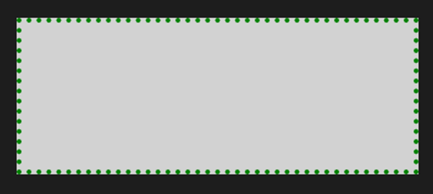
Customizing Styles (Contd.)
    To customize the style of the text box control as per the preceding requirements, you can add the following code snippet in the CSS file of the app:
      input[type=text]{
      height: 150px;
      width: 400px;
      border: 5px dotted green;
      }
    Output:
Notes:
9

Slide 10
Customizing Styles (Contd.)
  Styling a rating control:
  A rating control is added by using the following code snippet:
    <div data-win-control="WinJS.UI.Rating" />
  The preceding rating control is displayed with the default style.
  You can customize the appearance of the rating control by overriding the preceding default style.
  Example:
    The stars displayed in the rating control should be filled with white color.
Notes:
10
Explain App bar and App bar commands on similar lines.

Slide 11

Customizing Styles (Contd.)
    The following code snippet can be used to apply the preceding styles:
      .win-rating .win-star.win-user{
      color: white;
      }
    Output:
Notes:
11
Explain App bar and App bar commands on similar lines.

Slide 12


Just a Minute
  Which one of the following style sheets is mostly used by apps that display a lot of images?
    1. ui-dark.css
    2. ui-light.css

Slide 13
Just a Minute (Contd.)
  Solution:
  1. ui-dark.css

Slide 14
Demo: Applying Styles to UI Elements
  Problem Statement:
  Nancy has designed the UI for a Movie Rating app. Now, she wants that the app should have an appealing look and feel. For this, she wants to modify the appearance of the following elements:
    Labels:
      Font color is set to green
      Font size is set to 18 pixels
      Font family is set to Adobe Hebrew
      Left padding is set to 10 pixels
      Image needs to be resized to 125 x 125 pixels
    Heading:
      Font family is set to Adobe Hebrew
      Font color is set to blue
Notes:
14

Slide 15
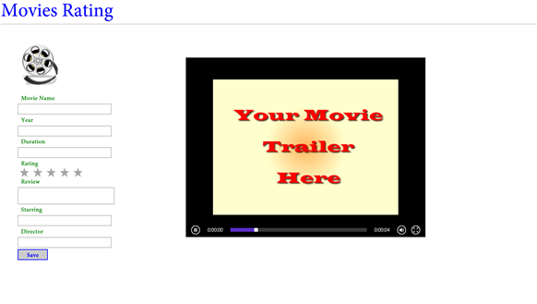
Demo: Applying Styles to UI Elements (Contd.)
    Buttons:
      Font family is set to Adobe Hebrew
      Font color is set to blue
      Font size is set to 18 pixels
      Height is set to 20 pixels
      Border is set to solid blue color border with 2 pixels width
  She wants that after applying all the changes, the UI of the app should appear, as shown in the following figure.
Notes:
15

Slide 16
Demo: Applying Styles to UI Elements (Contd.)
  Help Nancy in updating the look and feel of the app UI.
Notes:
16

Slide 17
Demo: Applying Styles to UI Elements (Contd.)
  Solution:
  To update the look and feel of the UI for the preceding app, Nancy needs to perform the following tasks:
    1. Change the style sheet to be used.
    2. Specify CSS selectors for UI elements.
    3. Add styles.
    4. Verify the created app.
Notes:
17

Slide 18
Summary
  In this session, you learned that:
  To create different types of looks based on the various requirements, you can apply styles to the UI elements of your app.
  You can include any of the following two style sheets in your app based on your requirements:
    ui-dark.css
    ui-light.css
  You can customize the styles of the UI elements by using the CSS file of your app page.
Notes:
18

Slide 19

Q&A

